Slide 1
CSE 3400 - Introduction to Computer & Network Security (aka: Introduction to Cybersecurity) Lecture 13 Public Key Infrastructure – Part II
Ghada Almashaqbeh
UConn
From Textbook Slides by Prof. Amir Herzberg
UConn

Slide 2
Outline
Certificate revocation.
Dealing with CA failures.
2

Slide 3
Certificate Revocation
3

Slide 4
Certificate Revocation
Reasons for revoking certificates
Security issues:
Key compromise, CA compromise
Administrative issues:
Affiliation changed (changing DN or other attribute), public key has been replaced, subject has ceased operation (company dissolving).
How to inform relying parties? Few options usually under three categories:
Prefetch: have revocation info in advance.
As-needed: ask for this info when a receiving a certificate and want to validate.
Neither: does not fall under any of the above, usually called network-assisted techniques.
4

Slide 5
Certificate Revocation Techniques
Prefetch:
Cons: higher storage and communication overhead,
Pros: lower response delay
As needed:
Cons: higher response delays, reliability issues, privacy concerns.
Pros: lower storage and communication overhead
We will start with studying two techniques:
Distribute Certificate Revocation List (CRL) -- Prefetch
This is part of the X.509 standard.
Ask - Online Certificate Status Protocol (OCSP) – As needed
5

Slide 6
CRLs
A certificate revocation list (CRL) is simply a list of revoked certificates.
Distributed periodically by CAs.
See next slide for its format.
If CRLs contain all revoked certificates (which did not expire)… it may be huge!
Yes, large storage and communication overhead.
CRLs are not immediate
Who is responsible until CRL is distributed?
Frequent CRLs ➔ even more overhead!
6

Slide 7
X.509 CRL Format
7

Slide 8
CRLs Optimization Solutions
More efficient CRL schemes:
CRL distribution point: split certificates to several CRLs
Authorities Revocation List (ARL): list only revoked CAs
Delta CRL – only new revocations since last `base CRL`
Need to keep CRLs for long period to check deltas → complicates implementation
Browsers mostly do not check CRLs. Instead they usually use:
Online Certificate Status Protocol (OCSP)
8

Slide 9
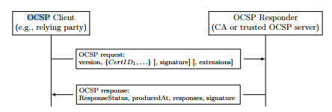
Online Certificate Status Protocol (OCSP)
Improve efficiency and freshness compared to CRLs
Client asks CA about cert during handshake
CA signs response (real-time)
9

Slide 10
Example - TLS Handshake with OCSP
Classical OCSP – Browser sends requests
10

Slide 11
OCSP Challenges
Cons of as-needed mechanisms mentioned before:
Privacy (expose domain and client to CA), load on CA, response delay, reliability (what if CA fails).
We will elaborate more on:
Ambiguity:
When an OCSP server (or CA) cannot resolve the request, it replies with ”certificate status is unknown”.
Reliability or failed requests.
Client failed to establish a connection with the OCSP server.
Or client’s request is invalid (not signed, or not authorized).
11

Slide 12
Ambiguous/Failed OCSP Responses
What should the client do?
Wait forever – unrealistic!
Hard-fail: terminate the connection since certificate is unknown.
Safe!
Ask user: application display a message asking the user how to proceed.
soft-fail: pretend that a response has been received and continue as the cert is not revoked.
Common choice for browsers!
But, a man in the middle attacker who may block the OCSP response to make a revoked cert go through?
See next slide.
12

Slide 13
MitM soft-fail attack on ‘classic OCSP’
13

Slide 14
Classic OCSP is Problematic → Use OCSP-Stapling
Subject of the certificate (aka web server) sends OCSP requests instead of the relying party (aka browser).
So subject acts as the OCSP client.
It receives a signed response back (signed by the CA and includes a timestamp) which it forwards to any relying party initiating a connection.
Browser accepts if signature is valid and time is recent enough.
Solves:
Privacy – the CA no longer knows about browsers access pattern
Reduce load – one request per website rather than many requests from browsers.
CA limits OCSP service to subjects – easier to manage.
14

Slide 15
OCSP-Stapling
15

Slide 16
OCSP-Stapling
Challenge: many servers don’t staple!
Or, worse: staple `sometimes/usually’
So, try OCSP? Connect anyway? Disconnect?
Usually browsers attempt to do classical OCSP then if no response, resort to soft-fail.
So we are back to the MitM attack described before.
Solution: `Must-staple’ cert. extension
RFC 7633
Mark as not critical
As it may not be supported by some browsers
16

Slide 17
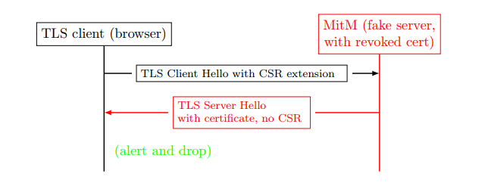
OCSP with Must-Staple Extension
Principle: Defenses should not be bypassed due to failures. If defenses are bypassed upon failure, attacker will cause failures to bypass defenses.
17

Slide 18
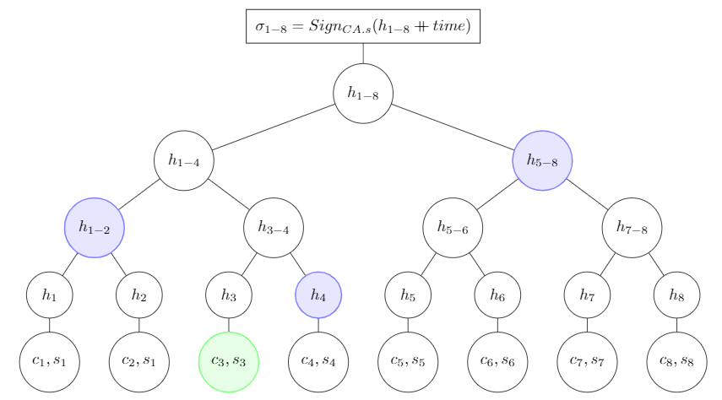
Optimizing OCSP Responses (1)
OCSP overhead is high – esp. if frequent
Several optimizations possible, e.g.: Merkle digest-tree and Proof-of-Inclusion (PoI).
Saves number of needed signatures (recall, public key cryptography is expensive)!
18

Slide 19
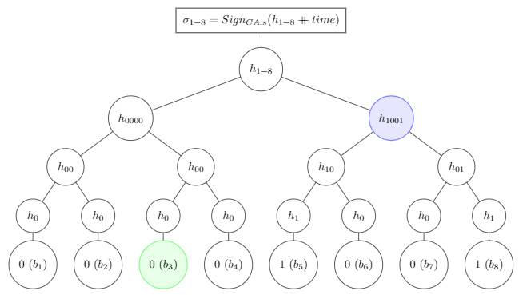
Signed Revocations-Status Merkle-Tree
A further optimization: send digest and PoI in revocations-status Merkle tree:
19

Slide 20
Dealing with CA Failures
20

Slide 21
Why and How CAs Fail?
Many CAs `trusted’ in browsers (as root)
Several well-known failures
DigiNotar, Comodo, Stuxnet, …
Every CA can certify any domain (name)
Name constraints NOT applied (esp. to roots)
Some CAs may be negligible or even rogue
Bad certificates:
Equivocation: rogue certificates for same name as a legit cert
Misleading certificates, e.g., similar name
Can we improve defenses against bad CA?
21

Slide 22
Defenses Against CA Failures
Use name constraints to limit risk
who can issue global TLDs (.com, etc.)?
Static key pinning: `burned-in’ public keys
Detected MitM in Iran: rogue DigiNotar cert of Google
Limited: changing keys? Which keys to preload ?
Dynamic Pinning: HTTP Public-Key Pinning (HPKP)
Server: I always use this PK / Cert / Chain
Client: remember, implement, detect & report attacks
Concerns: key loss/exposure, changing keys (recover security)
Still, Trust-On-First-Use (TOFU) can be helpful
E.g. for security policies: OCSP-must-stapling or CAs-pinning
Certificate Transparency (CT): Accountability
Public, auditable certificates log
22

Slide 23
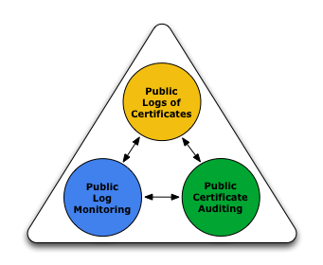
Certificate Transparency (CT) [RFC6962]
X.509: CAs sign cert
Accountability: identify issuer, given (rogue) cert
Challenge: find rogue cert
Unrealistic to expect relying parties to detect !
Google detected in Iran - since Chrome had pinned Google’s PK
Proposed solution: Certificate Transparency
Functions: Logging, Monitoring and Auditing
Three types of entities:
Loggers provide public logs of certificates
Monitors monitor certificates logged for detection of suspect certificates
Auditing (auditors?): check for misbehaving loggers
Google, CAs,…
Relying party
(browser)
CAs, Facebook, others
23

Slide 24
Certificate Transparency (CT): Goals
➔ Easier to detect, revoke rogue certificates
➔ Easier to detect, dis-trust rogue CAs: No (real) accountability without transparency!
What about rogue loggers ?
Option 1: Honest-Logger CT (HL-CT) [RFC6962]
Assume honest logger [out of two loggers – redundancy]
Option 2: NTTP-Secure CT (NS-CT):
Monitors, relying-parties detect misbehaving loggers
Relying party decides which monitor(s) it relies on (trusts) !
Original CT goal: ‘no trusted third party’
24

Slide 25
Honest-Logger CT: Issuing Certificate
Subject, e.g. website, sends request
Request contains ‘To Be Signed’ fields: name, public-key
CA validates request, signs cert, sends to logger
Logger adds cert to log, signs and returns (signed) SCT
CA sends cert + SCT to subject (e.g., website)
25

Slide 26
Detecting rogue certs in log: Monitors
Goal: early detection of rogue certs in log
Logs should be publicly available
Name-owners can monitor the log
Download, check log for relevant names
☹ high overhead to everyone!
Instead: monitors do this (for many names)
Several such monitors, loggers already operate
Download only new certificates
And: ask log for seq# and/or date of last logged cert
Ask log to send range of certs: <from-to>
Optionally: maintain all certs (to check new names)
26

Slide 27
Monitor Detects Rogue Certificates
Owner asks to monitor relevant domain names
Monitor asks for certs [Range, e.g., all new]
Usually periodically; assume daily (typical)
Monitor sends to owner new certs for same domain name
Or suspect as misleading: combo, homographic, similar,…
Domain
owner
Domain(s), $
Monitor
Send certs [from.. to..]
Logger
Logger
Logger
New certs
New certs
for domain
or misleading
27

Slide 28
Monitoring in Honest-Logger CT
28

Slide 29
HL-CT: Detecting Rogue Certificate
29

Slide 30
HL-CT: Omitted-Cert Attack by Rogue Logger
Collusion of rogue CA and rogue Logger
30

Slide 31
Security against Logger-CA Collusion: two options
Option 1: redundancy: SCTs signed by multiple loggers
Current approach in Google’s Chrome; req’s two SCTS (one Google)
If you require more redundancy… good luck finding certificates!
How many loggers? Which loggers? Overhead ?
Google’s logger + a logger selected by (untrusted??) CA
Option 2: avoid ‘honest-logger’ assumption
Two variants: AnG-CT and NS-CT
AnG-CT: Audit and Gossip to detect rogue logger
Roughly follows RFC6962 and original CT publications
Complex, expose user privacy, … : see textbook if interested
NTTP-Secure CT (NS-CT):
Ensures `no trusted third party’ by Proofs-of-Misbehavior (PoM)
31
Notes:
Note: many loggers are also CAs!

Slide 32
Audit-and-Gossip (AnG) Certificate Transparency
Logger keeps certs in Merkle tree
Protocol uses digest, PoI and PoC mechanisms
Signed, timestamped digest: Signed Tree Head (STH)
Logger must respond to several audit requests:
Request for STH+PoI, for given certificate
Request for PoC, for given pair of STHs
Request for current STH
Request for certificates, logged between given start/end times
Gossip: sharing of STHs among entities
To detect ‘split world attack’: different STHs to different entities
Textbook interpretation of `original’ CT
Using Audit and Gossip to detect rogue loggers
No complete spec published until now.
32
Notes:
Note: many loggers are also CAs!

Slide 33
What is missing in AnG-CT ?
AnG-CT may fail to provide Proof-of-Misbehavior
Logger never sends the STH for a rogue SCT !
Relying party receives no response… what can it do ??
Or, never responds to request for PoC for ‘rogue STH’…
Also: AnG-CT does not address revocation transparency ➔ vulnerable to ‘zombie certificate attack’: send ‘valid’ response to OCSP query for a revoked certificate
And: AnG-CT relying parties expose visited website
Next: NTTP-Secure (NS) Certificate Transparency
Also based on Audit and Gossip, but addressing above issues
NTTP = No Trusted Third Party (e.g., logger not trusted)
Simplified: no SCT, logger responds only daily with STH (can be changed to give SCT for immediate responses, certs)
33

Slide 34
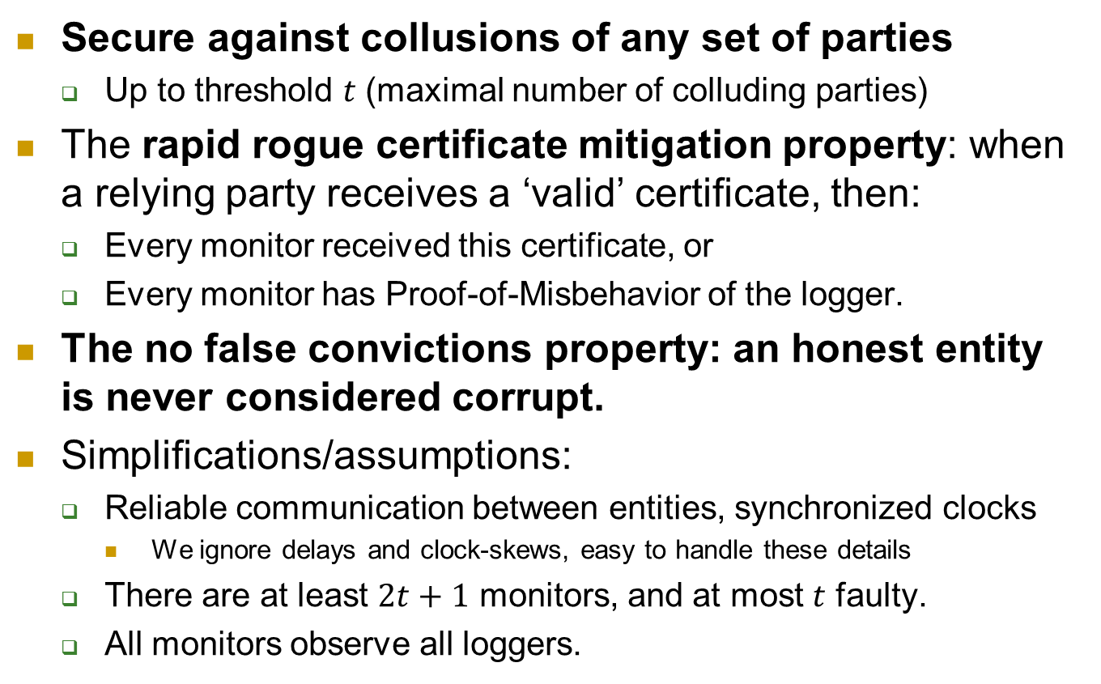
NTTP-Secure CT: Goals and Assumptions
Secure against collusions of any set of parties
Up to threshold $t$ (maximal number of colluding parties)
The rapid rogue certificate mitigation property: when a relying party receives a ‘valid’ certificate, then:
Every monitor received this certificate, or
Every monitor has Proof-of-Misbehavior of the logger.
The no false convictions property: an honest entity is never considered corrupt.
Simplifications/assumptions:
Reliable communication between entities, synchronized clocks
We ignore delays and clock-skews, easy to handle these details
There are at least $2t+1$ monitors, and at most $t$ faulty.
All monitors observe all loggers.
34

Slide 35
NS-CT : Simplification and Issue Process
Loggers issue Signed Tree Head (STH) every 24 hours
And `immediately’ provide it to all monitors
Response to CA includes STH and Proof-of-Inclusion (PoI)
CA, subject, relying party validate STH and PoI
Issue process almost unchanged – but takes 24 hours…
35

Slide 36
NS-CT: Audit detects an omitted cert
Logger
NewCerts, STH
Monitor
(Signed daily Log Digest)
PoI’, STH’
C’_{i}
CA
Req, pk, $
C’_{i} ,PoI’, STH’
Ok: Signed(STH)
or
Proof-of-Misbehavior (PoM): STH ≠STH’
STH’
Site
C’_{i} ,PoI’, STH’
Browser
36

Slide 37
Summary: benefits of CT
Benefits for websites:
Detect rogue certs for domain (same or misleading)
Once detected, owners can mitigate risk
Demand revocation, removal of CA from root program, …
Benefit to users: less likely to fall victim…
Benefit to trustworthy CAs: reduced competition from shady CAs
Overall: more secure PKI !
Not covered here:
Auditing and proving misbehavior of rogue monitors
The Zombie-certificate attack
Transparent revocation in NS-CT (prevents Zombie-cert attack)
37

Slide 38
Covered Material From the Textbook
Chapter 8:
Sections 8.4, 8.5, and 8.6

Slide 39

Thank You!

